Slide 1
ANLY 699 Applied Project
Lauren Taber

Slide 2
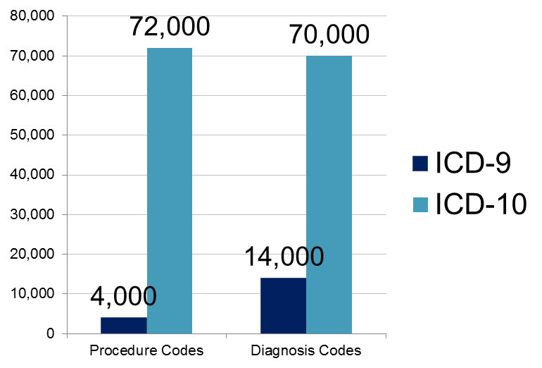
Background
Historically, medical codes have been used primarily for patient billing; however, “the system cannot adequately accommodate dramatic advances in medicine and medical terminology” (Bowman, 2008).
4,000 ICD-9 codes are being replaced by 72,000 ICD-10 codes to improve accuracy in medical billing and reporting

Slide 3
Purpose
Apply Analytic Techniques to the ICD-10 Coding System
Grouping
Text Analytics
Data Analytics
Develop Application that Provides Search and Filter Functionality and Statistical Information
Notes:
To help minimize the stress this new influx of codes is putting on the medical coders, there needs to be a system that includes features that aid users in selecting the appropriate codes. It should also be designed to handle the increased load on the processing system caused by the significant increase in data.

Slide 4
Data Source
Retrieved from: http://www.cms.gov/Medicare/Coding/ICD10/2015-ICD-10-PCS-and-GEMs.html
Sample:
Index | Code | Valid | Short Description | Long Description
00001 | 001 | 0 | Central Nervous System, Bypass | Central Nervous System, Bypass
00002 | 0016070 | 1 | Bypass Cereb Vent to Nasophar with Autol Sub, Open Approach | Bypass Cerebral Ventricle to Nasopharynx with Autologous Tissue Substitute, Open Approach
00003 | 0016071 | 1 | Bypass Cereb Vent to Mastoid Sinus w Autol Sub, Open | Bypass Cerebral Ventricle to Mastoid Sinus with Autologous Tissue Substitute, Open Approach
Notes:
Official set of ICD-10 procedure codes.
Retrieved from: http://www.cms.gov/Medicare/Coding/ICD10/2015-ICD-10-PCS-and-GEMs.html
2015-PCS-long-and-abbreviated-titles.zip
icd10pcs_order_2015.txt
Dataset contains invalid codes (“headers”) and valid codes. Headers help group the data.

Slide 5
Data Processing
Import to Excel as csv
Identify data types and labels
Code, integer
Valid, binary
Short Description, string
Long Description, string
Location, string
Identify relationships
Parent_of
Load data and relationships into Neo4j database
Notes:
Data Labels
Code, text
Valid, number
Short Description, text
Long Description, text
Location, string (retrieved from long description of header)
Relationships
Invalid codes are substrings of valid codes; parent/child relationship
First 3 digits of code identify location of procedure

Slide 6
Tools
Source
Processing
Storage
Analytics
Microsoft Excel
Text File
Neo4j Graph Database
RStudio
Shiny Analytics
User Interface

Slide 7
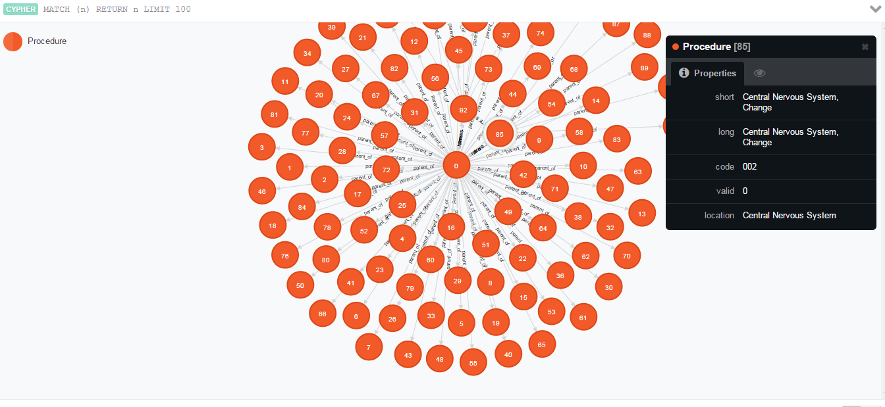
Database
Sample size: 100

Slide 8
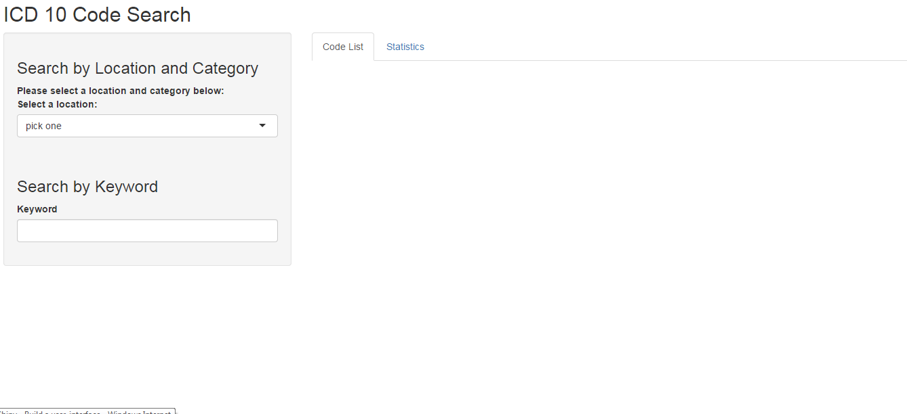
Application
Initial Screen
Notes:
The application consists of 2 search features and 2 results lists.
Search
Dynamic filter on location and category (referencing header Long Description)
Keyword Search on Long Description of all valid codes

Slide 9
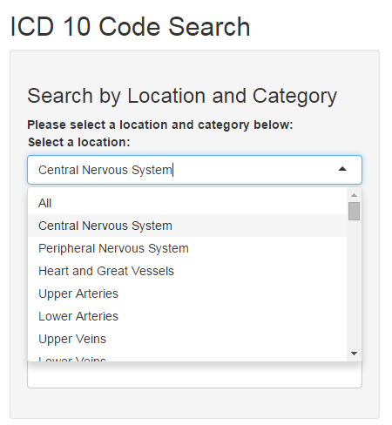
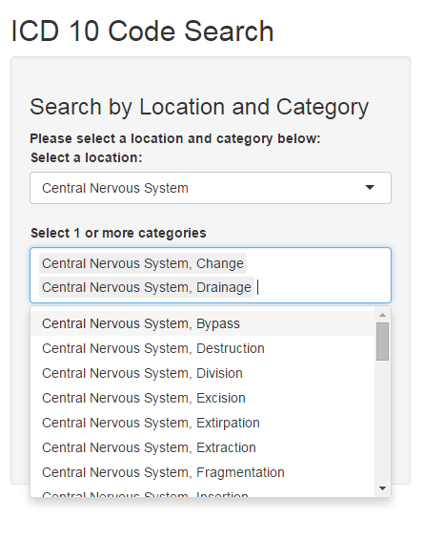
Dynamic Filter Selection
Notes:
The locations are the distinct list of location labels from the database. There is also an option to select “All” if the user would like to bypass the first filter criteria. Based on the user’s first choice, a second dropdown will appear with a list of categories. The user may choose one or more of these categories to populate the results tabs. The results will not be populated for this filter unless a category is chosen. The categories are populated by selecting header nodes that have a label consistent with the Location selection made by the user. If the user selects “All” from the Location dropdown, all header nodes will be displayed in the Category drop down.

Slide 10
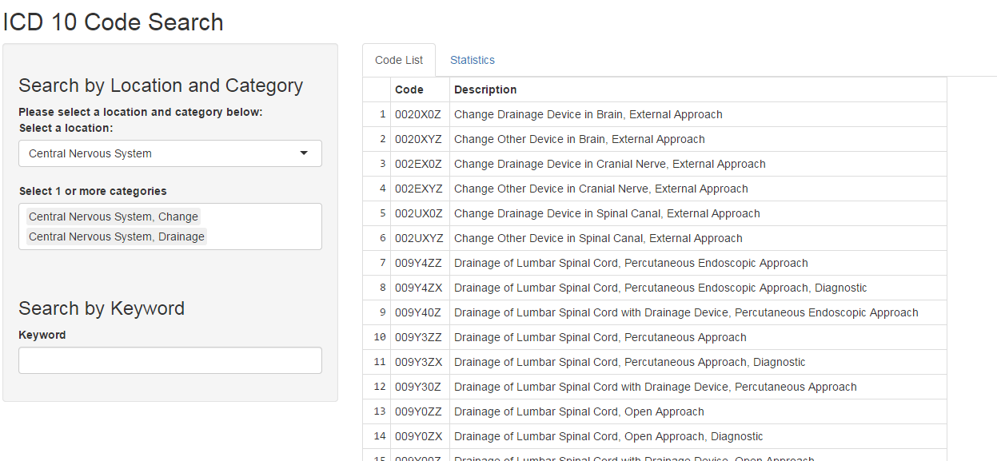
Output
Notes:
The results set will only contain valid codes and descriptions based on the search criteria. They are displayed in ascending order by code.

Slide 11
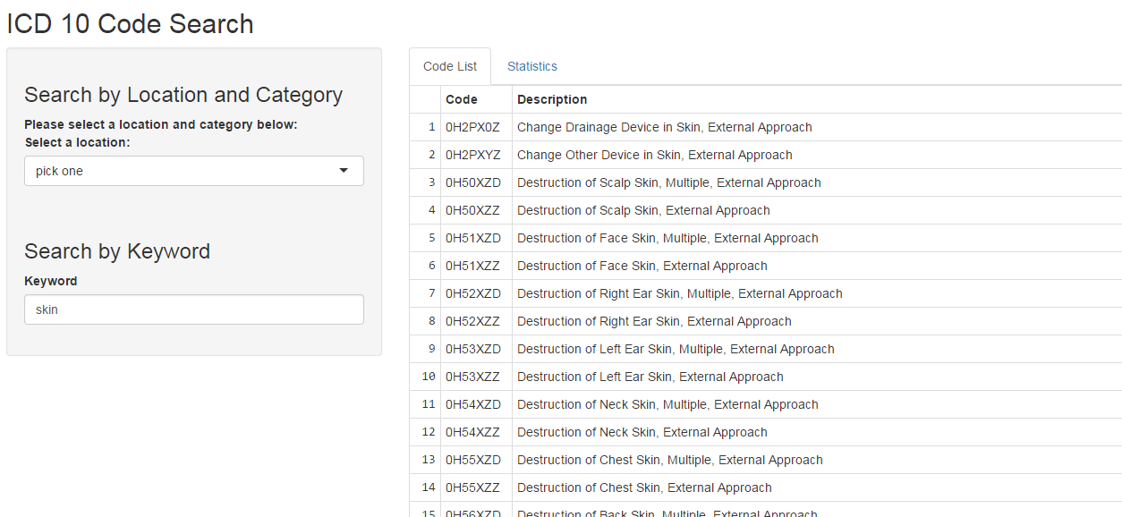
Keyword Search
Notes:
The keyword search is case insensitive and searches for the substring within the Long Description of each node. It does not take into consideration the location or category selections made in the other search feature. It only returns valid codes and ignores headers.

Slide 12
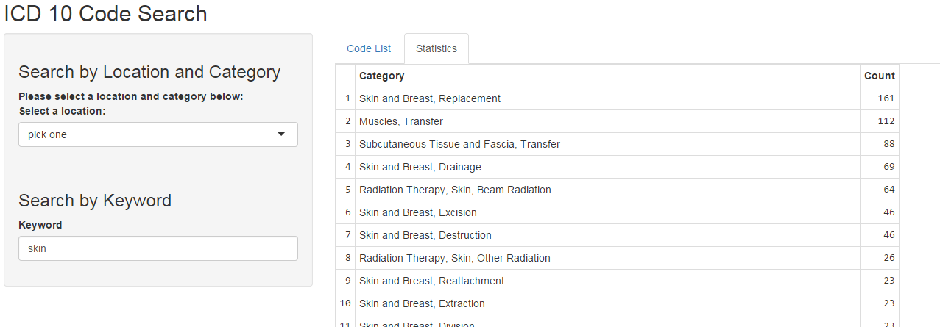
Statistics
Notes:
When a user selects this tab, it will display, in decreasing order, a count of how many codes fall under each category for the given results set. This was done in order to help the user identify which category may be the most applicable to their search and thereby help them narrow the filters used so that a smaller results set can be obtained.

Slide 13
Conclusion
Extensions
Addition of location subsets as additional filter.
Found in long descriptions of valid nodes but difficult to extract from the string
Recommendation list
Nodes ranked by how often they appear in the results set and how often the user selects that code as the one they were looking for
The recommendation list could be prepopulated with the highest ranked codes
Update dynamically based on any search criteria the user enters.
Notes:
Next steps could include….
Additional filters
Recommendation lists

Slide 14
References
Bowman, Sue. (2008). "Why ICD-10 Is Worth the Trouble." Journal of AHIMA 79, no.3 24-29.
2015 ICD-10 PCS and GEMs. (2015). 2015 PCS Long and Abbreviated Titles [Data File]. Retrieved from: http://www.cms.gov/Medicare/Coding/ICD10/2 015-ICD-10-PCS-and-GEMs.html

